Slide 1
Beach Monitoring App
Team Phoenix
2/2/17
Notes:
Louis- Hello I am Louis Barea and we at team phoenix are here to walk you through our Beach monitoring app for the Wisconsin DNR and health services

Slide 2
Summer interns and employees at Wisconsin DNR
A cognitive walkthrough
Notes:
Louis- So we are giving you a cognitive walkthrough today with 2 scenarios all dealing with a user of our application, one a nominal use and another that is not as fortunate.

Slide 3
Users
Environment
Wisconsin DNR employees and health department employees
These employees work with the data collected by these apps to inform the public
Student Interns, Volunteer groups, and Trained Surveyors
These people use the app directly and input the data while at the beach
Wisconsin Beaches
All 15,074 lakes in the state of Wisconsin are needed to be surveyed so that all people may know if they are safe to be in, as well as employees and organizations can keep a history of the status of those lakes
Notes:
Louis- Before diving into those examples though we need some background on our users and environment. First the users of the app include DNR and health department employees who either receive and use the data or also go out and get the data themselves as trained surveyors. Next we would have students who are interns going out to the beach and doing these surveys. We could also have volunteer groups do the same thing as these interns. Lastly the environment this app will be used at is one of the 15,074 lakes in the state of wisconsin which may or may not have wifi and or data or celluar service.

Slide 4
Scenarios
Nominal Use Case Scenario
Error Handling Use Case Scenario
An intern is assigned to collect data at a Wisconsin beach. After arriving at the beach, they open their beach survey app on their mobile phone, login, and begin a new data collection session. This takes the intern to a page with a form in which they can enter data about the beach. After the intern finishes collecting data, he reviews the data he entered and attempts to submit the data, causing the app to save the data collected locally. Because the beach does not have wifi, the app notifies the intern that the data could not be uploaded and stores their data as an unfinished survey. When the intern has wifi again, they can view and upload their survey.
A member of a volunteer group participates in collecting data at a Wisconsin beach. After arriving, they open up the beach survey app, and begin a new survey without logging in. While collecting survey data, it begins to rain, so the volunteer saves the current survey to resume it later, and retreats to find somewhere dry. Their survey is saved on the device, so when the rain passes, they return to the beach and resume collecting data. When the volunteer is finished, they review their data and notice several inaccurate data points. The volunteer corrects these and attempts to upload their survey. Unfortunately, they do not have wifi and are notified that the results could not be uploaded. The survey is saved locally and is added to their list of unfinished surveys, which they can upload later when they have a wifi signal.
Notes:
Miles - We have two use case scenarios, a nominal use case that describes an ideal usage of the app with no problems, and an error handling use case in which the user encounters likely problems while using the app

Slide 5
Nominal Use
Notes:
Miles - Now I will demonstrate a cognitive walkthrough of the nominal use case. If we have enough time, I will also demonstrate a walkthrough of the error case.

Slide 6
Paper Prototype Views - Nominal Use
Home page - lists all previous surveys and those that have yet to be submitted
From here, user clicks login button if they haven’t previously logged in
Notes:
Miles - When the user opens the app, they will see a home page

Slide 7
Paper Prototype Views - Nominal Use
Login page - this is a modal appearing above the rest of the page
Tapping outside the modal will cancel the login
Notes:
Miles - Pressing the login button will take them to this page

Slide 8
Paper Prototype Views - Nominal Use
Now that the user’s logged in (indicated in upper right where the login button was), they may press “New” to start a new survey
Username
Notes:
Miles - After logging in, the user sees their username in the upper right corner. The user presses the “new” button to start a new survey

Slide 9
Paper Prototype Views - Nominal Use
Data Entry - closely related questions may be grouped into pages, though this will only happen if it will not result in scrolling on most modern phones

Slide 10
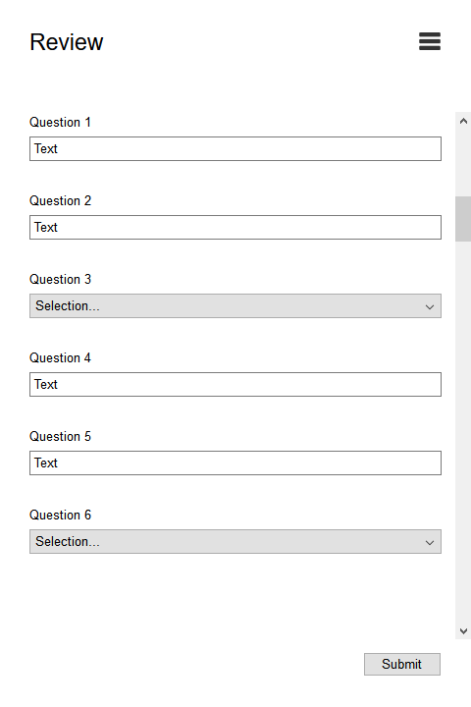
Paper Prototype Views - Nominal Use
Review Page - This is the last page before surveys are submitted
Users may edit values here
Submit button is sticky to the bottom of the screen
Once the survey is submitted, users are redirected to the Home Page and notified whether the survey was submitted successfully or not

Slide 11
Error Case

Slide 12
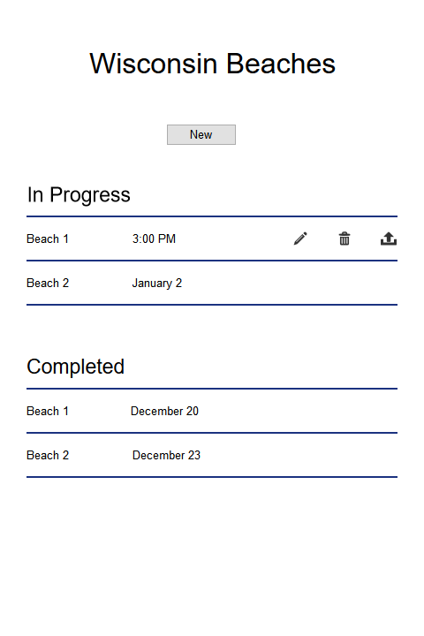
Paper Prototype Views - Error Case
Home Page - User starts out by tapping “New”

Slide 13
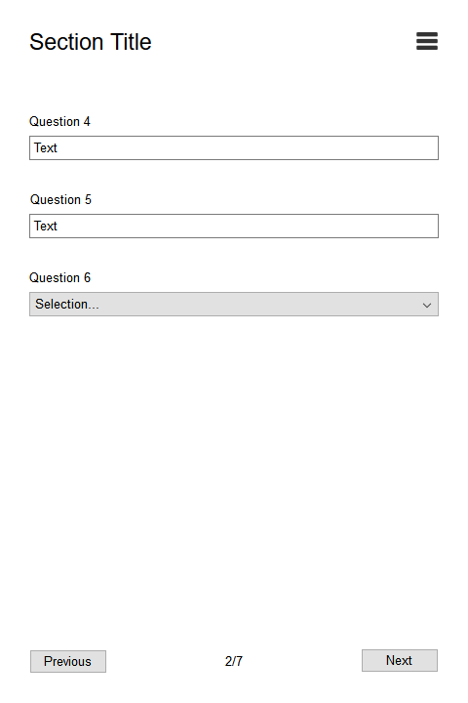
Paper Prototype Views - Error Case
Data Entry - User starts entering data for their beach...

Slide 14
Paper Prototype Views - Error Case
… Unfortunately, they are interrupted and return to the Home Page
From here, they may tap an “In Progress” survey to be given options to continue editing, delete, or review and submit the survey (if it’s complete)

Slide 15
Paper Prototype Views - Error Case
Data Entry - The user opted to edit their existing survey, and were brought to the last page they had open

Slide 16
Paper Prototype Views - Error Case
Review - The user is now ready to review and submit their data

Slide 17
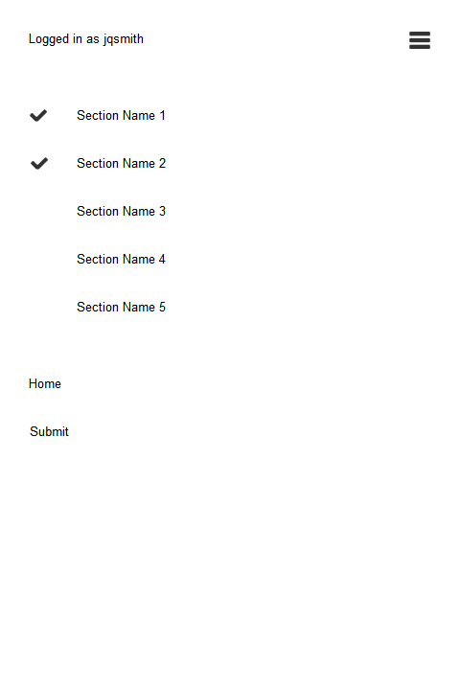
Paper Prototype Views - Error Case
Menu - The user has decided they would like to answer survey questions out of order
They also realized they have not yet logged in, and do so from here
Notes:
Home should be “Home (saves current survey)” or something like that, thought of after the mockup was put together

Slide 18
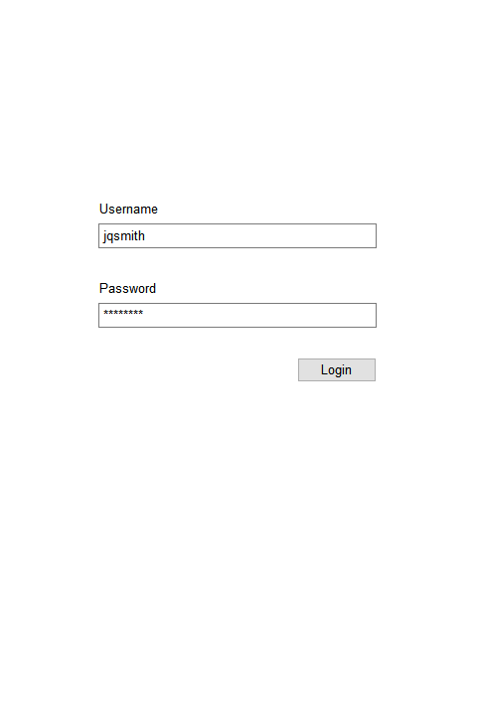
Paper Prototype Views - Error Case
Login - This is a modal over the menu this time

Slide 19
Paper Prototype Views - Error Case
Review Page - Now the user is logged in and ready to submit his data

Slide 20
Paper Prototype Views - Error Case
Home Page - The user was brought here after submitting
If his submission were to fail, the survey would be returned to the “In Progress” section so he could try to submit again
Username

Slide 21
Usability Goals
Effective - The users must be able to record survey information, even with sporadic, or no cellular coverage.
Learnable - The UI should be familiar to users, and it should be clear which button to press to achieve a desired action.
Safety - If the user loses wifi, their data should be safe and they should still be able to upload it when they have wifi again. They should also be able to review and fix any incorrect data they entered before uploading it.
Notes:
Louis- our application was designed with several usability goals in mind to ensure that users can accomplish their tasks reliably. READ OFF SLIDES

Slide 22
Usability Concerns
The large amount of data must be easily displayed yet able to be easily distinguished and clicked on
The users will be outside so the ability to read the screen in the sun is a factor, as well as inclement weather
User authentication with limited to no cellular service while out at the beaches
User should be able to easily find the beach that they are at
Notes:
Louis- before and after this walkthrough we clearly have several usability concerns with this application. READ OFF SLIDES

